Slide 1

What Every Junior Should Know!
WELCOME CLASS OF 2026
What should you be doing?
1

Slide 2

Agenda
Counseling team
Counselor Contact information
College and Career Center
Graduation Requirements/ In State University Requirements
Junior To Do List (Athletes, College Fairs, Dual Enrollment)
In State Universities/Community Colleges/Trade or Tech school options
College Entrance Exams
Scholarships
Transcripts
ECAP- Reality check
Personal/Emotional support

Slide 3
Counseling Team
A-CE Ms. Spilsbury
CH-GE Mr. Maluski
GI-KN Mr. Snyder
KO-NA Mr. Dillon
NE-SH Mr. Smith
SI-Z Ms. Thompson
Social Worker Wargaski ( Room C101)
Get to know your counselor!
Ms. Fassinger - Career Center, C106
Mrs. Blancarte –Counseling assistant
2

Slide 4

How do I contact my counselor and get other helpful information?
Opt into your counselor’s Google Classroom—if you are new, send an email to your counselor to be invited.
Remember, no staff member receives emails to the GSE account; email to lastname.firstname@cusd80.com to correspond with your counselor.
Basha webpage—Our Staff—Counseling—bookmark this and view every 2 weeks for updates—check out the Overview first please! Then locate the JUNIOR FOLDER on the left.

Slide 5

Basha College and Career Center
Mrs. Fassinger – C106
Join the College and Career Center Google Classroom Classwork for BHS College/Career Center (google.com) Sign in with your GSE Account.
Enter Code: lrb5ua5 to join the classroom!
College & Career Center Padlet at:
  https://padlet.com/fassingerrita1/basha-high-school-college-career-center-417il3xmdem9rc0g
Scholarships
Jobs
Military
Volunteer Opportunities
CGCC Rep on campus Tuesday/ Thursday/ EVERY OTHER FRIDAY in Career Center C106. email for appt- BE SURE TO INCLUDE YOUR NAME AND SCHOOL (BHS) krysten.marshall@cgc.edu

Slide 6

Class of 2026
Graduation Requirements
Area English Math Science Social Studies Physical Education (class) Fine Arts/CTE Comp. Health Electives | Credits 4 4 3 3 1 1 .5 5.5 + MUST PASS CIVICS EXAM
22 Credits Total to Graduate
4

Slide 7



In state University (16 core competencies)
Area English Math (ONE ABOVE ALG 2 LEVEL) Science (LAB SCIENCES) Social Studies (INCLUDES AM/AZ HISTORY) Fine Arts or CTE Foreign Language (SAME LANGUAGE – OR THROUGH LEVEL 2 OF ANY FOREIGN LANGUAGE) NAU EXCEPTION | Credits 4 4 3 2 1 2 _________ 16
REMEMBER
Your unweighted GPA will be recalculated using these 16 courses to determine admission.
4

Slide 8

University Bound Juniors
To Do’s
Take the PSAT ( October 21-25)
$25 REGISTRATION NOW OPEN. Go to Basha website under academics
Testing / PSAT (cusd80.com)
Research universities and colleges you are interested IN ATTENDING.
Attend College fairs
Meet with College Representatives. (Check dates with Mrs. Fassinger)
Check out Dual Credit opportunities
See how credits transfer by visiting http://www.aztransfer.com/
Take ACT or SAT, spring semester. (All Juniors taking free ACT on April 10, 2025
Search for scholarships.

Slide 9
Athletes
Athletes: Make sure that you register spring semester with NCAA/NAIA in order to be eligible for scholarship opportunities. Apply online @ https://web3.ncaa.org/ecwr3/
See Mr. Snyder in Counseling if you have ?’s.
Register for the NAIA at www.playnaia.org
Once you are registered- let your counselor know so we can flag you as a potential athlete

Slide 10
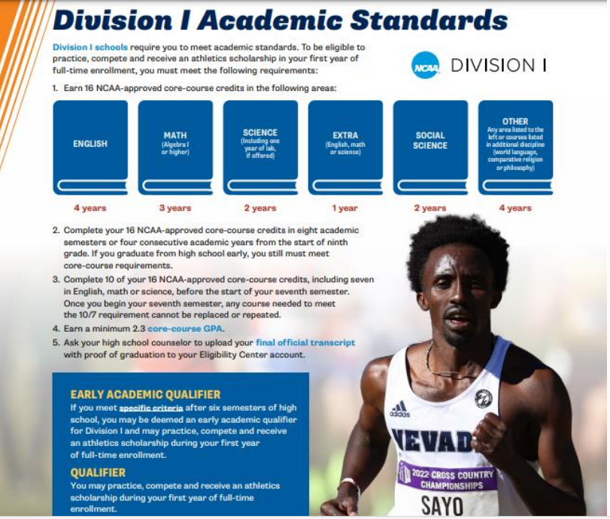

NCAA QUALIFICAITON
REQUIREMENTS

Slide 11
CUSD College Fair
Opportunities for everyone!
When: Wednesday, September 18TH 6- 8 pm
Where: Hamilton High School
Universities ( In State and Out of State schools)
Community Colleges
Trade Schools
Military Representatives – US Army, US Marine Corps, US Navy, AZ National Guard
**See full list of participating schools in your counselor’s google classroom

Slide 12
Greater Phoenix National
College Fair
Attend National College Fair (NACAC)
Sunday, September 15, 2024
11 AM – 3 PM
2024 Greater Phoenix National College Fair (collegefairguide.com)

Slide 13
Dual Enrollment
Dual Credit Courses may be applied toward college degree. High school credit + college credit. Cost is based on community college rate per credit hour.
Go to this site for 24-25 information
Dual Enrollment / Overview (cusd80.com)
For a list of classes offered as dual enrollment click “high school class lists” (make sure you meet all listed pre-requisites).
Begin your registration process with CGCC. Registration begins August 1. Deadline is Sept 13
NEED help? CGCC Rep on campus Tuesday/ Thursday/ Every other Friday in Career Center C106. Email for appt- BE SURE TO INCLUDE YOUR NAME AND SCHOOL (BHS) krysten.marshall@cgc.edu

Slide 14
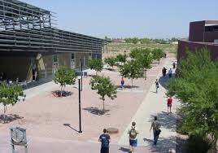



What are you doing after BHS?
64% of BHS graduates attend a 4-year University
22% of BHS graduates attend a community college
What do the rest of our graduates do???

Slide 15
ASU Uof A NAU
3.0 unweighted 16 core GPA or better OR top 25% | 3.0 unweighted 16 core GPA through your sixth semester OR top 25% | 2.75 unweighted 16 core GPA (Foreign language may be considered)
ACT or SAT not required but may be submitted. ACT/SAT scores may help fulfill competency req’s ACT/SAT scores may be considered for scholarship | Test Blind for Honors Admission. ACT/SAT scores may help fulfill competency req’s ACT/SAT scores may be considered for scholarships. | ACT and SAT scores may be considered for Honors. ACT/SAT scores may help fulfill competency req’s ACT and SAT scores may be considered for scholarships.
Be sure to check out individual websites for current year information

Slide 16



Interested in attending a Community College? This is what you should be doing:
Meet with the CGCC Rep (on campus Tuesday/ Thursday/ EVERY OTHER FRIDAY) in Career Center C106. email for appt- be sure to include your name and school ( BHS)
Check the Career Center calendar for upcoming presentations.
Research scholarships throughout the year.
Register as a student and take CC placement exams if needed.
      2nd semester senior year (January or February)

Slide 17
Community College Career Opportunities
Chandler Gilbert CC
Aircraft Construction Technology
Aviation
Computer Information Systems
Early Childhood Programs
Exercise Science and Physical Education
Food Science technology
Media Arts: Dig. Imaging
Mortuary Science
Mesa CC
Automotive service
Caterpillar technician training
Construction trades
Forensic Science
Landscape Horticulture
EMT
fire science/ firefighter
Nursing
welding
Scottsdale CC
Artificial intelligence
Culinary Arts
fashion
film
Yoga Teaching Certification
Hospitality management
Broadcasting
Gateway CC
Court Reporting
Automotive Technology (Partnership w/ Nissan)
Hydrologic Studies
Nursing
Massage therapy
Pipefitting/plumbing
Respiratory care therapy
*These are only a few of the different programs & colleges available*

Slide 18
Apprenticeship Opportunities
An apprenticeship is a semi-formal way of learning a skill or trade While also receiving a salary. Although you work with someone at a participating job, you may also attend classes.
Usually, 3-5 years in length over 800 occupations.
  Apprenticeship Program | Arizona Department of Economic Security (az.gov)

Slide 19




Tech and Trade Schools
Vary in size, entry requirements, cost and quality
Research
Visit the school
Speak with students and employers
Technical and Trade Schools - May 2021 OEWS Industry-Specific Occupational Employment and Wage Estimates (bls.gov)
Arizona Tech & Trade Schools (short list)
Arizona Automotive Institute
The Refrigeration School, Inc
AZ Vocational Training
East Valley Institute of Tech.
Conservatory of Recording Arts
UEI College
AZ Medical Training Institute
Carrington College
Pima Medical Institute
Avalon Institute-Beauty School
Cortiva Institute

Slide 20
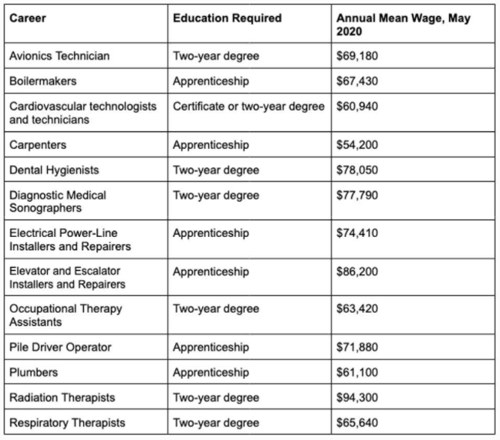
Trade School
Career/Education/Pay

Slide 21

Military Bound
Take the ASVAB (Armed Services Vocational Aptitude Battery). November 19th
Sign up with Mr. Unger in the front office Before fall break
    Explore career options available through each of the branches.
Military representatives are occasionally in the cafeteria during lunch.
Involve your parents in the process.

Slide 22
College Entrance exams
ACT v. SAT
www.collegeboard.org
Scores up to 1600
2 Sections: Reading/Writing and Math
2.5 hour exam
No penalty for wrong answers
www.act.org
Scores from 1-36
3-hour exam measures 4 areas: English, Math, Reading and Science. Writing is optional
No penalty for wrong answers
BHS SCHOOL CODE 030037

Slide 23
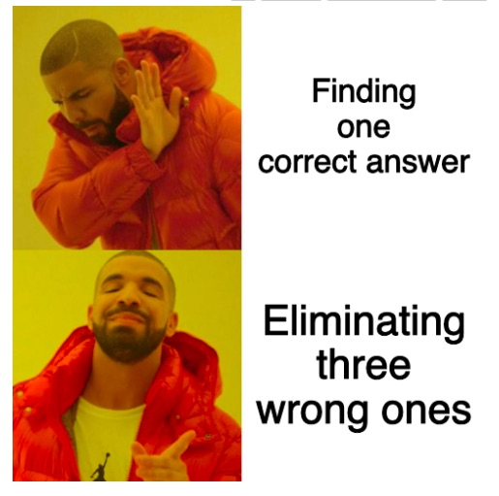
Importance of Doing Well on the ACT and SAT
College recruiting
Admission decisions
Advisement and placement
Scholarship opportunities

Slide 24

SAT/ACT Prep Classes
Ms. Fassinger career center padlet – College testing and test prep info
https://padlet.com/fassingerrita1/417il3xmdem9rc0g
Utilize collegeboard and ACT websites for info on free online test prep
  ACT: www.actstudent.org/testprep
  SAT: www.satpractice.org (powered by Khan Academy)

Slide 25

Types of Scholarships
Merit Based
  Automatically considered based on application (In State Univ.)
  Grades, GPA in high school, & possible Test scores
  Out of State (Check their websites)
Non-merit Based
(you search and apply for). Varied
  Sports
  Private
  Leadership
  Service
  Financial Need
  Financial Aid
  Grants

Slide 26

Applying for Scholarships
Check scholarship Info Career Center
Career Center / Overview 3 (cusd80.com)
See her Padlet
https://padlet.com/fassingerrita1/417il3xmdem9rc0g
Join her Google classroom
Use this code to join: lrb5ua5
See Mrs. Fassinger in C106
Request applications
Update your resume
Follow directions
Allow time for letters of recommendation (2 weeks)
Stay involved
15
MEET DEADLINES!!

Slide 27

Scholarship Search Engines examples
  Fastweb.com
    https://www.fastweb.com/ppc?utm_source=google&utm_medium=ppc&gclid=CP-GqNqTjc8CFQuAfgodhjwPpw
  Collegeboard.org
    https://bigfuture.collegeboard.org/scholarship-search
  Scholarships.com
    https://www.scholarships.com/
Don’t pay for scholarship searches!

Slide 28
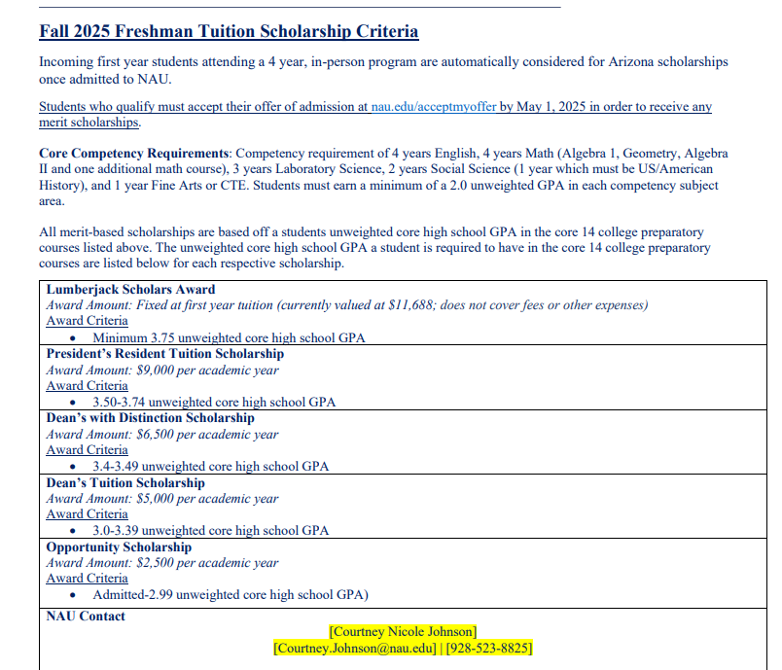
NAU Scholarships

Slide 29

NAU Lumberjack Scholarship
Tuition Waiver to NAU
Renewable for all 4 years
3.75 GPA core (Based on unweighted 14 or 16 core GPA)
No deficiencies
7th semester transcript must be received around January or February
See your counselor if you think you qualify!
Questions may be directed to Courtney Johnson courtney.johnson@nau.edu
928-523-8825
SCHOLARSHIP ESTIMATOR
https://app.meadowfi.com/nau

Slide 30

ASU Scholarship Estimator Tool
https://scholarships.asu.edu/estimator
Use this webpage to estimate potential scholarship based on these criteria.
Unweighted core GPA
ACT or SAT test score (if you have one)

Slide 31
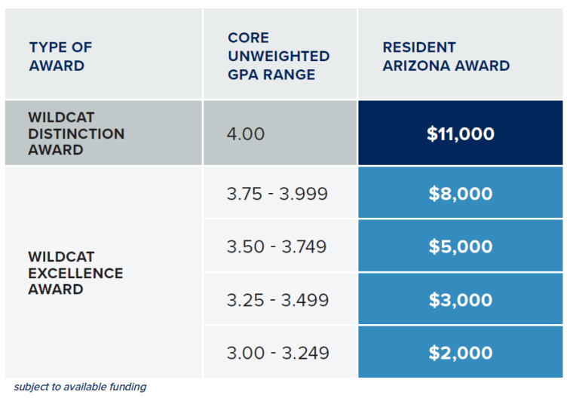
UNIVERSITY OF ARIZONA SCHOLARSHIP AWARDS
BASED ON 6TH SEMESTER CORE UNWEIGHTED GPA
Resident and Non-Resident Merit Tuition Awards Based on GPA
Use the following chart to determine which Tuition Award you qualify for based on your 6th semester core unweighted high school GPA.
Domestic Resident Awards
Image

Slide 32
Maricopa Community Colleges Presidential HONORS Scholarship
COVERS 4 SEMESTERS
Unweighted GPA 3.25 or higher (based on 8th semester final GPA)
Enrolled as a Full-time student (12 credit hours)
Enrolled in one honors class (3 credit hours)

Slide 33
Transcripts
Academic record of semester grades and select standardized test scores.
Unofficial copies: Guidance Counselor
Official copies: Parchment
https://www.parchment.com/u/registration/598213/account
First 5 are free after $3.00 - $5.00 per copy
Use your official legal name that is on your school information when registering.
Register with codes provided.

Slide 34
Graduation Honors
Cum Laude- 3.75-4.24 weighted GPA
“with praise”
White Cord
Magna Cum Laude 4.25-4.49 weighted GPA
“with great Praise”
Black Cord
Summa Cum Laude 4.5-5.0 weighted GPA
“with Highest praise”
Gold cord

Slide 35

JUNIOR ECAP- REALITY CHECK
Log into Infinite Campus
MORE tab
Under QUICK LINKS- Choose “CLEVER”
UNDER Helpful Links- CHOOSE “MY FUTURE AZ”
Create account using your GSE Email
**IF YOU NEED TO RESET YOUR PASSWORD- USE gse EMAIL AND RESET. THEN LOG IN AGAIN

Slide 36

Once logged in go to….
Career Exploration
Resources
Filter by: Additional assessments
Reality Check
Begin- Select Expenses or Career. Base this on your chosen career after completing school or training

Slide 37


Slide 38

Select the box that
pertains to the
lifestyle you would
like to live as an adult.
You will be able
to select
multiple boxes
for some categories

Slide 39
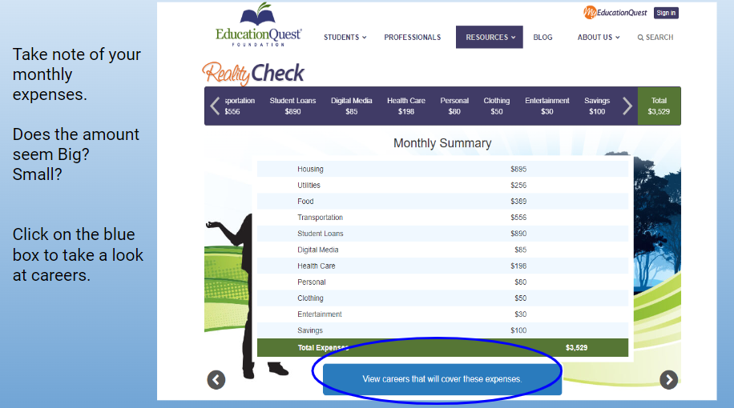

Slide 40


Slide 41

It’s okay to not be okay
Notes:
Introduce topic of mental health and the importance of getting help for yourself or a friend who is struggling. Let students know that it is ok to not be ok, there is help available.
Explain the topics to be discussed:
A helpful app that is free for you to download.
The warning signs we should all look for- state them
Review Teenlifeline & 988 - mental health, safety concerns for yourself or someone else
Social Media and how that can affect our mental health
And then end with some additional resources when help is needed
Play video and discuss students’ initial thoughts. - How does this make them feel, what stood out to them, etc

Slide 42

A Friend Asks App
Get Help Now
How to Help a Friend
Warning Signs
Resources for Help
Notes:
A Friend Asks App is a free app you can use if you or a friend are struggling or at risk of suicide.
The Get Help Now icon is there if you need help immediately due to a emergency or crisis situation.
Another icon in the app is called “How to help a friend.” We want to focus on this area specifically today. This icon takes you into another page that has options of: warning signs, how to ask, what to do, and what not to do. We will be focusing on What to do.
We will also be reviewing warning signs to be aware of and end with resources that are available for you.
Review the What to do icon, this is important information for them to walk away with:1. Listen carefully - sometime just listening is so helpful, you don’t have to know what to say 2. let them know you care - be supportive and not judgemental 3. Take it SERIOUSLY - never assume your friend is joking, ask your friend directly if they are thinking about hurting or killing themselves 4. Seek help - Find a trusted adult you can ask for help (ask students who they could go to for help). Remind them that their school counselor, social worker, teacher are there to help. Specific resources shared at the end of presentation.

Slide 43
Warning Signs
Decline in school performance and behavior
Changes in school attendance
Talking, or joking, about suicide or making suicide threats
Loss of interest in things they used to enjoy
Unusual interest in death and dying
Taking unnecessary risks
Feelings of hopelessness
Depression
Bullying - Both the target of bullying and the bully are at risk
Change in Friendships - withdrawing from friends and social activities
Mood swings or personality changes
Increased use of alcohol or drugs
Giving away prized possessions
Changes in eating and sleeping habits
samsha.gov
Notes:
Four out of five individuals considering suicide give some sign of their intentions, either verbally or behaviorally.
Review Warning signs on slide
Highlight that this is not an all encompassing list. Encourage students to trust their gut when talking to their friends. If you are concerned about someone, take action - seek out an adult right away. When in doubt take action- it’s better to lose a friendship that lose a friend. When we take action we communicate that we care deeply about that friends well being.

Slide 44

988
988 offers 24/7 access to trained crisis counselors who can help people experiencing mental health-related distress. That could be:
Thoughts of suicide
Mental health or substance use crisis, or
Any other kind of emotional distress
People can call or text 988 or chat 988lifeline.org for themselves or if they are worried about a loved one who may need crisis support.
Notes:
988 is a new resource that you can call, text or chat if you or someone you know is having thoughts of suicide or experiencing a mental health crisis or substance use crisis.
988 connects you directly to free, confidential, and compassionate support. When you call, text or chat 988, you’ll be quickly connected to trained crisis counselors who will listen to your concerns, provide support, and connect you to additional resources if needed. You can chat at 988lifeline.org.

Slide 45


Effects of Social Media
Teen Voices
Notes:
Show Teen Voices video. Explain that what they see on social media is not necessarily true of what is happening in a person’s life. Ask for examples (families that look “Perfect” but are actually struggling, filters used to look better, posting pictures with friends when they actually feel very alone) This would be a great opportunity to point out the stat saying that 54% of teens fear that their friends are having more fun than them.
Discuss some of the statistics in the graphics. The image on the left gives great information regarding how attached teens are to their phones - using it before bed and as soon as they get up.
Blue graphic on the right - great stats on how their thoughts about their appearance can be negatively altered based on social media.
Ask students to share how they feel that social media has impacted their lives (distracted from studying, spend more time alone and less with friends/family, increases arguments with parents/guardians, etc). Ask students if they have ever taken time away from their phones and what that felt like, how did it impact their life?

Slide 46
RESOURCES
988 Suicide Crisis lifeline
Teen Lifeline 602-248-TEEN (8336)
Text Crisis Line 741-741
Suicide Prevention Lifeline 800-273-TALK (8255)
Empact 480-784-1500
Notes:
As discussed in the previous slide, sometimes concerns are too big and need additional outside support from a trusted adult. A trusted adult can be a parent, family member, school counselor, coach, teacher, social worker, mentor, or other adult you feel safe speaking to.
On our campus, to schedule an appointment with a school counselor or social worker (EXPLAIN school procedure here). It is important to note that as a school counselor, we keep what you share with us confidential unless you share someone is hurting you, you want to hurt someone, you want to hurt yourself, or you give me permission to share the information with another adult.
Other resources off campus include these on the slide. I am going to hand out a Suicide Prevention card that discussed Suicide Warning Signs, Things to Remember, as well as these phone numbers listed on it.
In an immediate emergency, always call 911. The other numbers listed can assist if you or someone you know need help. Some of these phone numbers may look familiar such as the Teen Lifeline phone number. The Teen lifeline phone number can be found on the stickers in school buses as well as the back of your student identification. Teen Lifeline is a FREE RESOURCE, so please don’t hesitate to call.
***Students could be allowed to take out cell phones to enter phone numbers into contacts. Discuss that these are FREE resources.
If after listening to this presentation, you would like to speak to a counselor please (EXPLAIN procedure for following up with students that day and the location for finding a counselor.)

